Slide 1
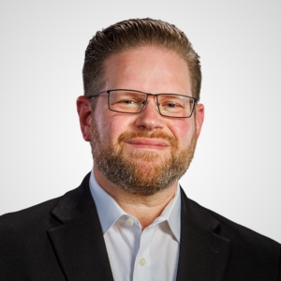
CENTRI TEAM
Max is a Partner at Centri Business Consulting and the leader of the firm’s M&A Advisory Practice. He has more than 20 years of merger and acquisition consulting experience and provides M&A advisory services to private equity firms, venture capital firms, family offices, and strategic/corporate clients. He joined Centri in October 2022 and specializes in providing merger and acquisition advisory services for both strategic and financial buyers and sellers. Max provides value-added services such as buy-side due diligence, sell-side due diligence, sell-side consulting, sell-side readiness, buyer valuation support, working capital analysis/support, restructuring advisory, and strategy and legacy consulting. During his career, Max has provided consulting services on over 600 transactions and has been responsible for leading all aspects of the deal process. Max has consulted on deals with enterprise values ranging from $2 million to $6 billion.
Prior to his time with Centri, Max was at RSM US LLP for 7 years, where he most recently served as the Deal Strategy North American Practice Leader, specializing in providing full deal lifecycle services such as development of acquisition strategies, sell-side go to market strategy development, enterprise valuation analysis, financial modeling, drafting of marketing materials (e.g., confidential information memorandums), and deal management.
Prior to RSM, Max spent several years at KPMG and PwC in their Transaction Advisory Service Practices, providing buy-side and sell-side financial due diligence services. He also has 5 years of experience working with a financial services firm with a focus on high-net-worth individual/family wealth management, business consulting, and merger and acquisition consulting.
Max is a board member and the former treasurer of the Philadelphia chapter of the Association for Corporate Growth (ACG). Max also serves as a board member and local leadership of the Philadelphia Chapter of the Exit Planning Institute (EPI).
Max received a Bachelor of Science degree in Accounting from Susquehanna University.
Maxwell Heller
Partner
M&A Advisory
Practice Leader
mheller@CentriConsulting.com
215-654-6850 [Ext. 704]

